Slide 1
Senior Development project
Megan Moore

Slide 2
AGENDA
Project introduction
Primary goals
Objectives
Growth
Execution | Demonstration
Questions | Analysis

Slide 3



INTRODUCTION
Primary goal: Build connections with past professional work and newly acquired skills.
• Add functionality to an existing website powered by a content management system.
• Explore connecting APIs and external databases to a site using a CMS.

Slide 4

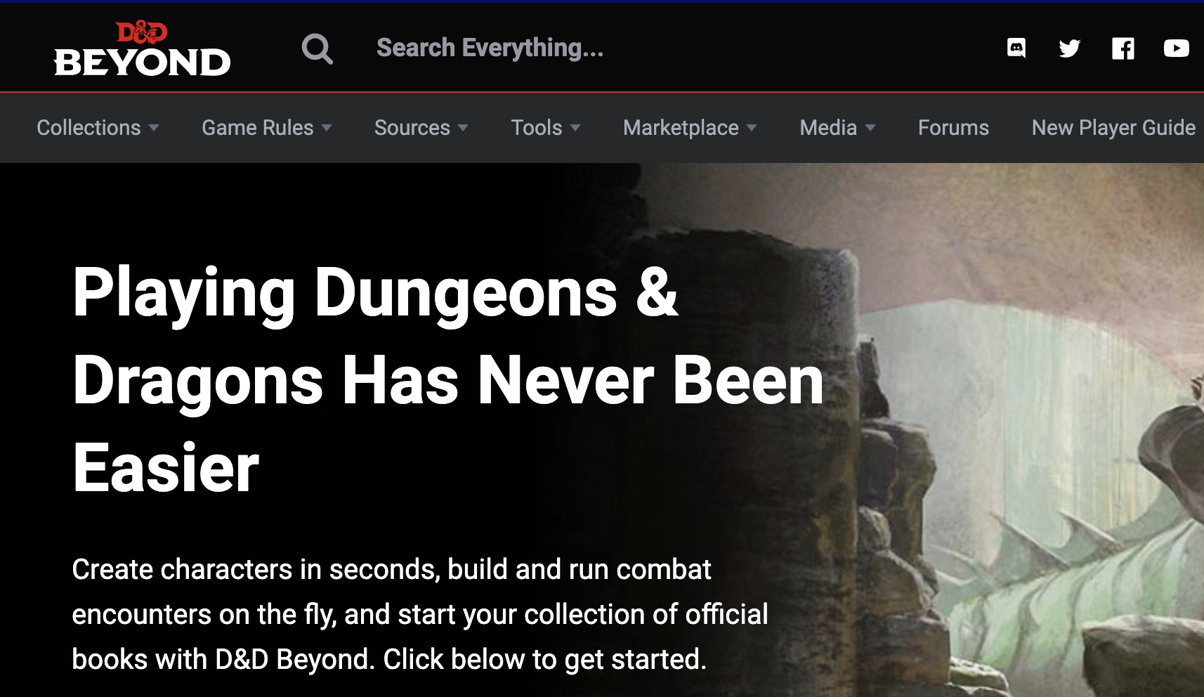
I decided to create a D&D hub for my son and his friends. None of them can afford to pay for the features they’re interested in on D&D Beyond, and creating this would allow me to do the following:
• create connections between databases and a boilerplate WordPress site
• explore connection possibilities with existing plugins
• create an environment where users can upload and post content with little to no administrative access.

Slide 5
PRIMARY GOALS
SENIOR WEB DEVELOPMENT PROJECT

Slide 6
Create a basic WordPress site that looks clean and professional.
Develop the user registration process, enabling login and upload of content. Let content be searchable when user grants permission.
Utilize both an external API and uploaded JSON files to power a character generator resource.
Create a hub of interactive resources.

Slide 7
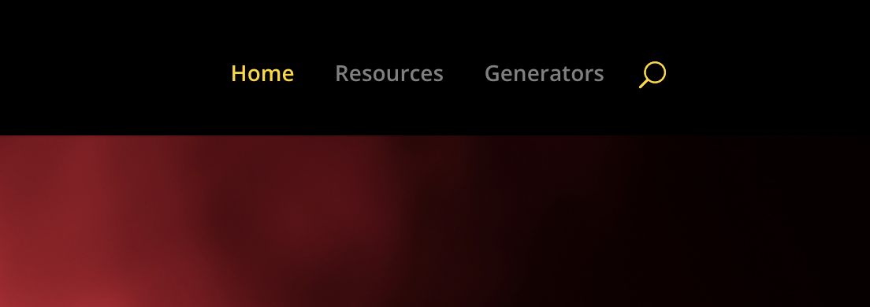
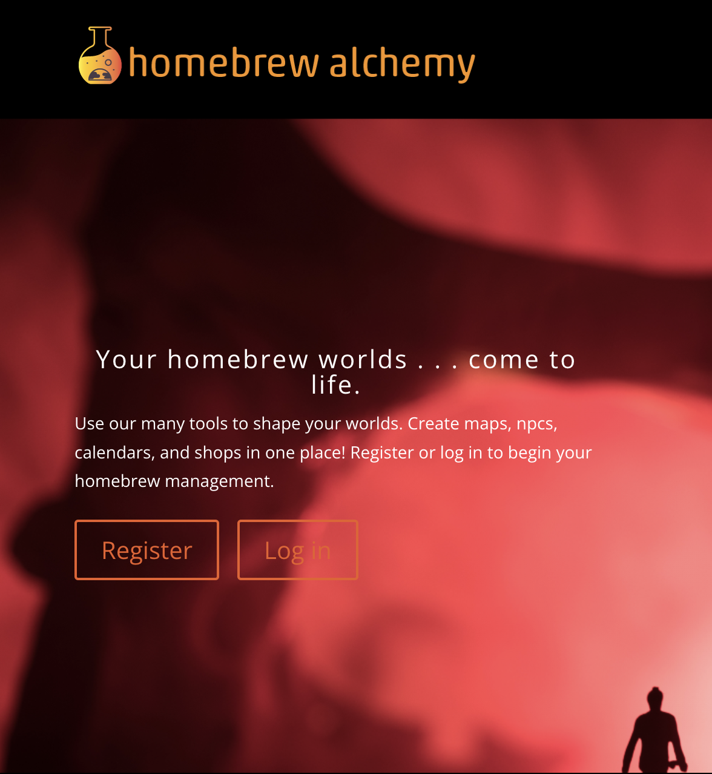
Objective 1 Site creation and setup
Create a website on WordPress containing the following main pages:
- Home
- Resources
- Generators
2. Site is live and has a good flow of information. Everything displayed works.
3. Site is deployed, responsive, and styling is consistent.

Slide 8
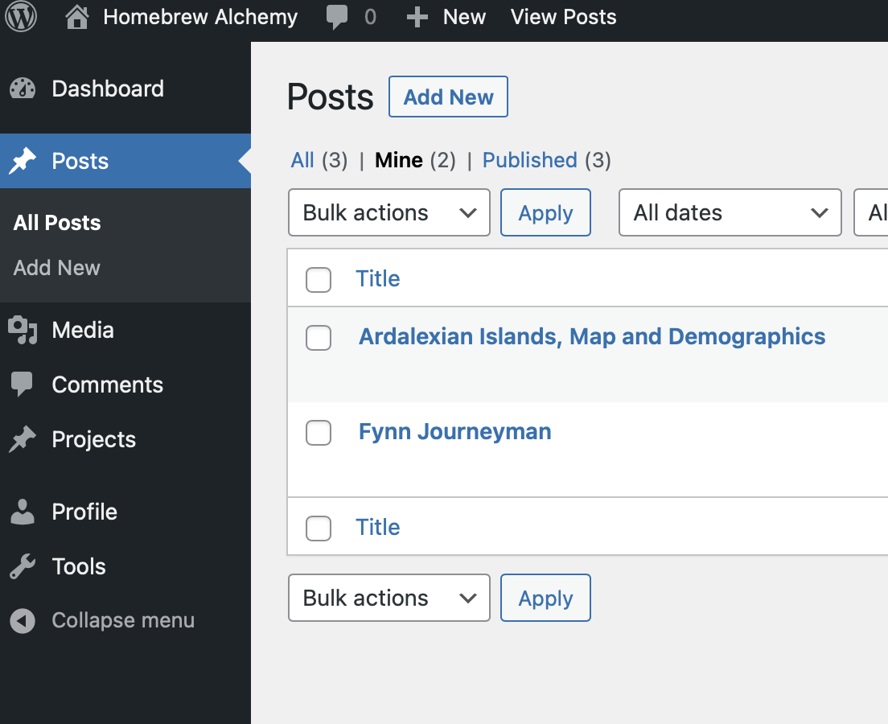
Objective 2 user registration and permissions
User is able to register, log in, and has permission to add or update their own content.
User is able to upload and display content: lore, maps and images.
Content that has been marked shareable by the user can be searched.

Slide 9
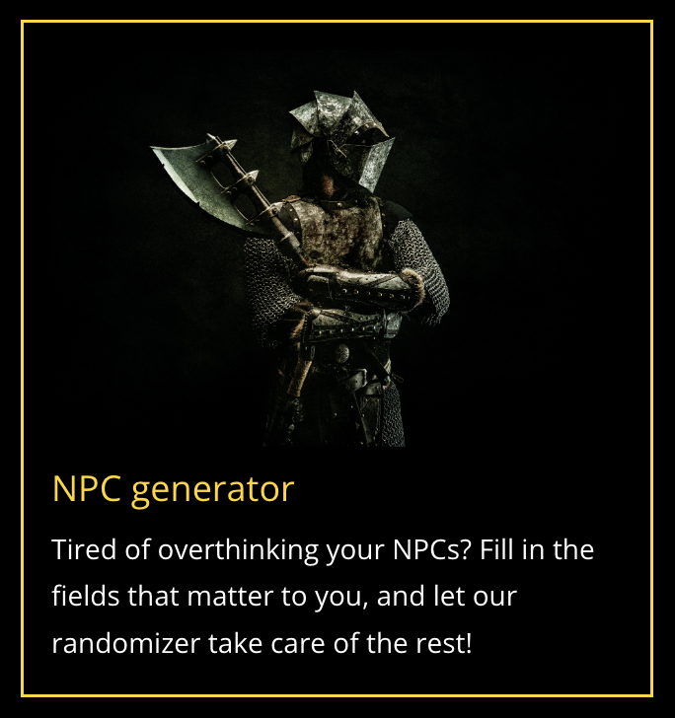
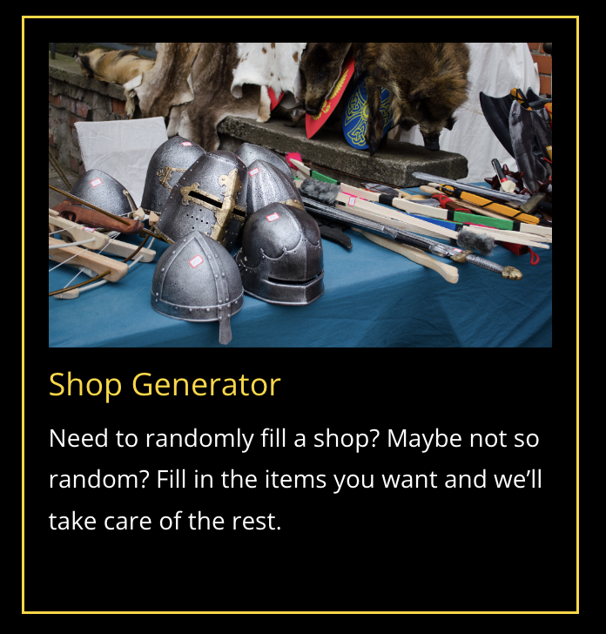
Objective 3 generator resources
A random NPC generator is created using uploaded JSON files which interactively generates a character with name and various traits.
A random shop generator utilizing an external API is used to create a shop generator which randomly fills a shop with contents as requested by category.
Both generators work and are responsive.

Slide 10
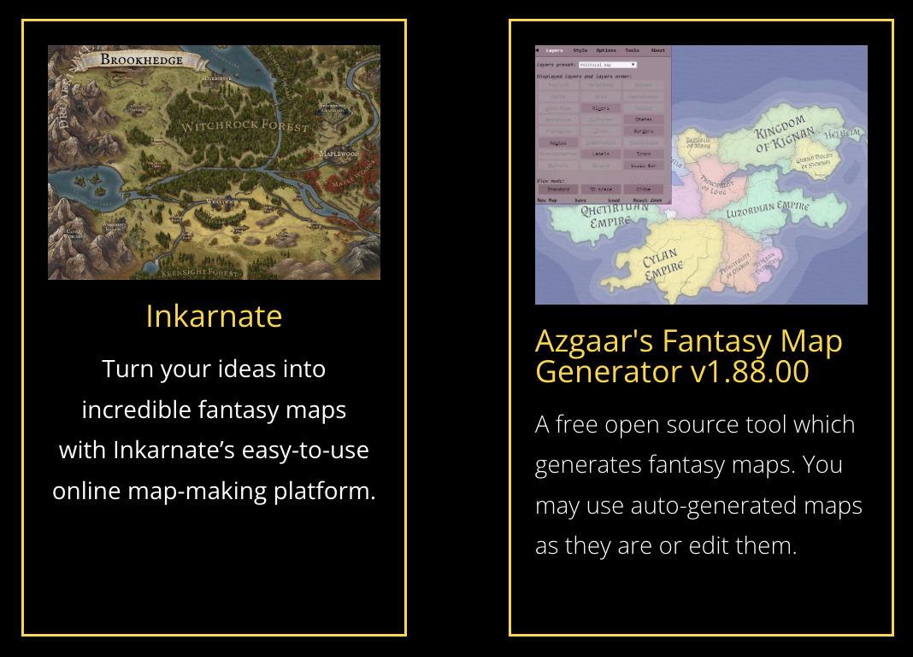
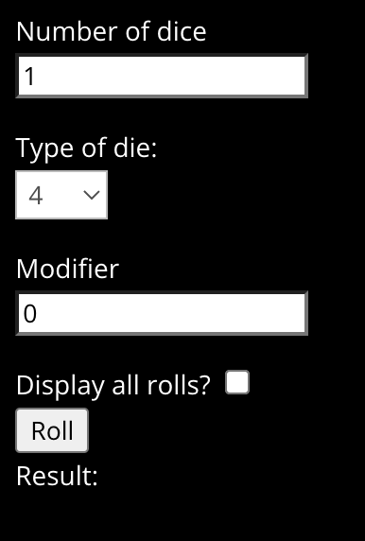
Objective 4 Free resource hub
Links with featured free resources appear, including links to featured content created by users.
Page displays a dice roll simulator plugin which is consistent with style guides.
All resources and content work and are responsive.
User-created content supports comments.

Slide 11
Areas of growth
SENIOR WEB DEVELOPMENT PROJECT

Slide 12
Honed skills
• Enlarged knowledge base of WordPress CMS best practices.
• Increased ability to perform CRUD operations.
• Further practice connecting to external APIs.
• Creation and utilization of child themes.
• Understanding of PHP and JavaScript languages, especially the limitations and appropriate uses of each within the WordPress CMS.
SENIOR WEB DEVELOPMENT PROJECT

Slide 13
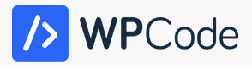
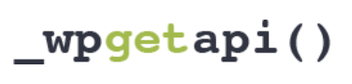

Acquired skills
• Knowledge of and experience with WordPress plugins, such as WP Forms, Custom Fields, Code Snippets and WP Get API.
• Connection to an external API through a CMS.
• Navigating and altering WP theme files.
• Insertion of custom JS and PHP code into a website run by a CMS.
• Creation of a WP plugin created with Python.
• Creation of a React fetch application.
• Exploration of jQuery and Bootstrap components.
• Exploration of WordPress action and filter hooks.
• Creation and usage of a web scraper.
SENIOR WEB DEVELOPMENT PROJECT

Slide 14
Attributions
IBRAHIMA NDAW
MDN WEB DOCS
GITHUBCONNECTED
FREE CODE CAMP
FLATICON
MEGHAN BUCHER
_WPGETAPI()
OPEN5E DJANGO REST API
MDBGO DOCS
JETPACK DOCS
SENIOR WEB DEVELOPMENT PROJECT

Slide 15
Execution | Demonstration

Slide 16
Questions | Analysis
SENIOR WEB DEVELOPMENT PROJECT

